Slide 1
PIA 3121
22 September 2026
Neo-Neo Debate

Slide 2
PIA 3121 Schedule
1 Sept: Tools of Analysis / Foundational Concepts
8 Sept: Realism
15 Sept: Liberalism
22 Sept: Neorealism and Neoliberalism
29 Sept: Economic Structuralism and Globalization
6 Oct: Constructivism
13 Oct: MIDTERM QUIZ
20 Oct: Ontological Security Theory
27 Oct: The English School
3 Nov: Democratization / Global Culture / Revolution
10 Nov: Critical Theory / Gender in IR / Global Civil Society
17 Nov: Chaos and Complexity in IR / Existential Risks
24 Nov: FINAL QUIZ DUE / Discussion of Group Projects
8 Dec: GROUP PAPER PROJECT DUE

Slide 3
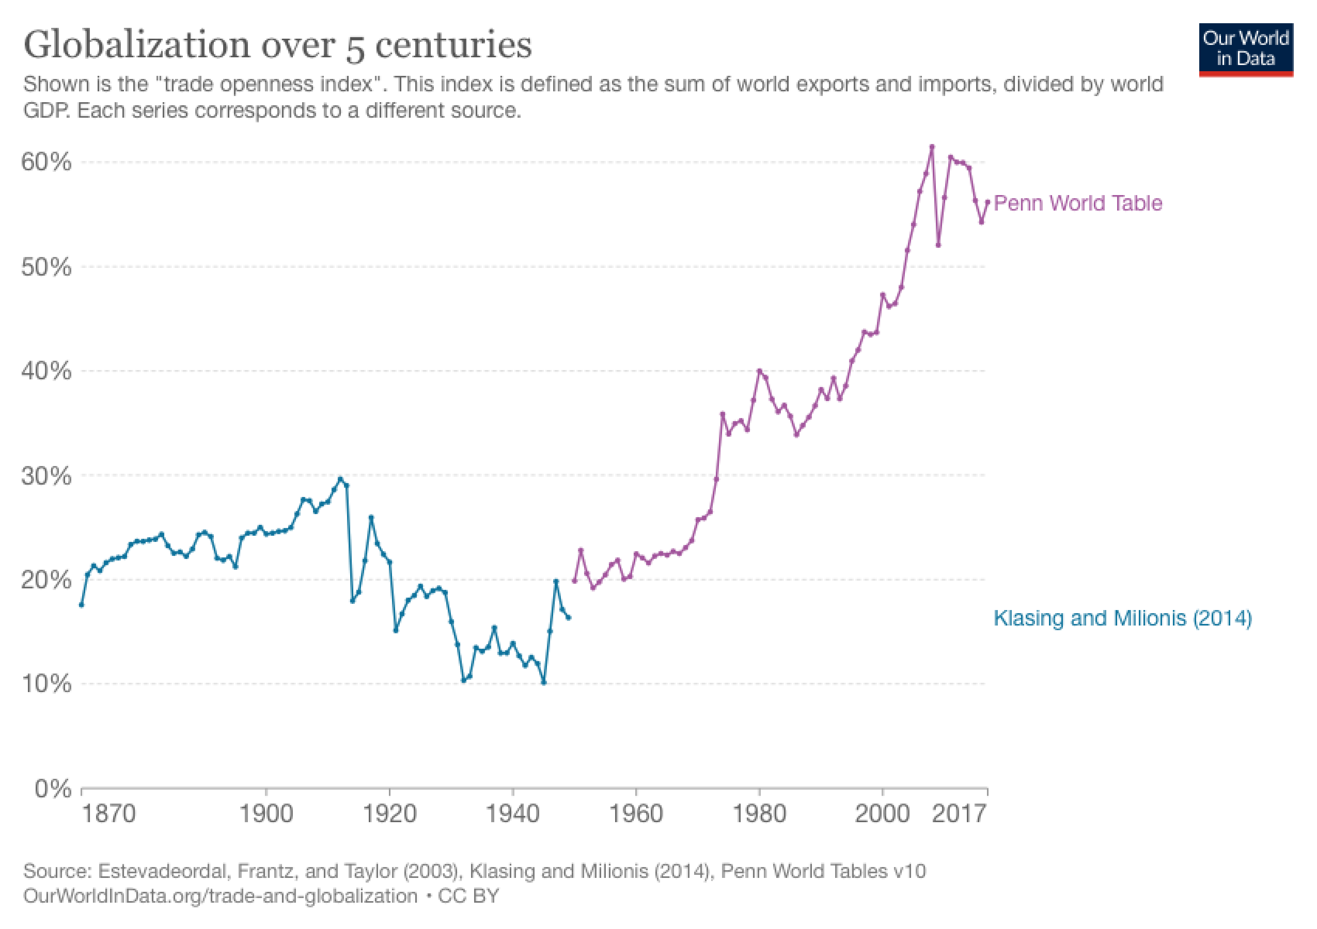
How could globalization have happened under anarchy?

Slide 4
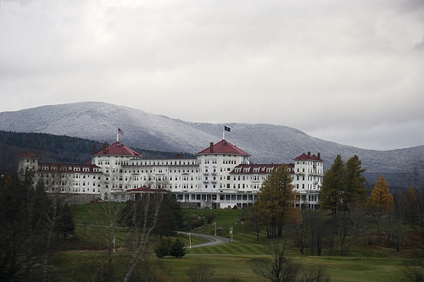
The post-WWII international trade regime originated in Bretton Woods, NH

Slide 5
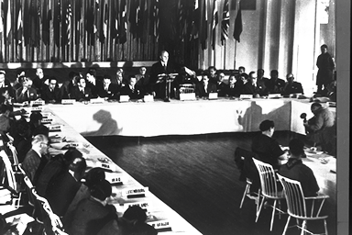
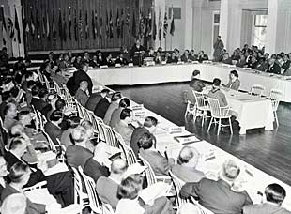
History being made at Bretton Woods (July 1944)

Slide 6
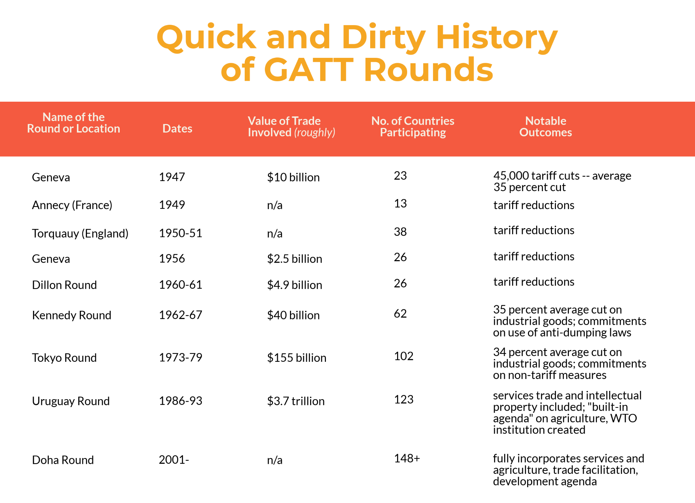
SOURCE: https://tradevistas.org/gatt-rounds-who-what-when/

Slide 7
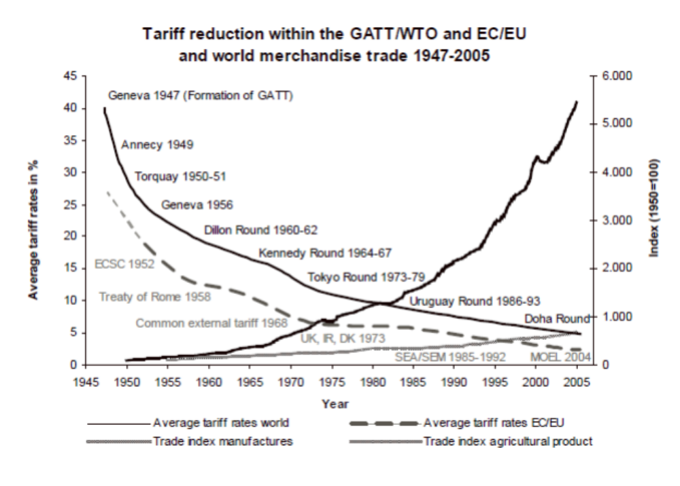
SOURCE: https://www.princeton.edu/~pkrugman/GATT.pdf

Slide 8
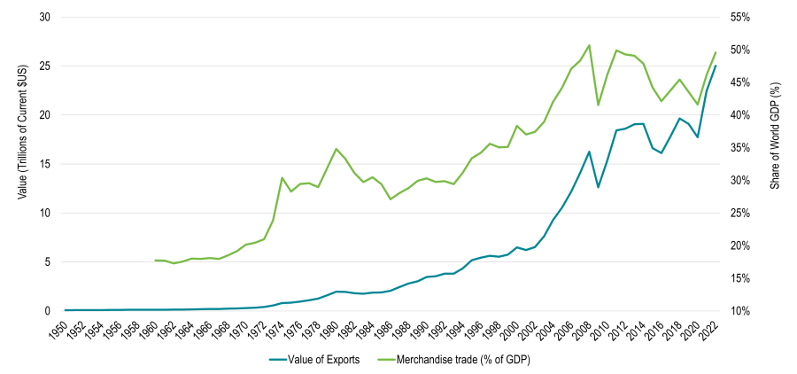
The Growth of World Trade

Slide 9
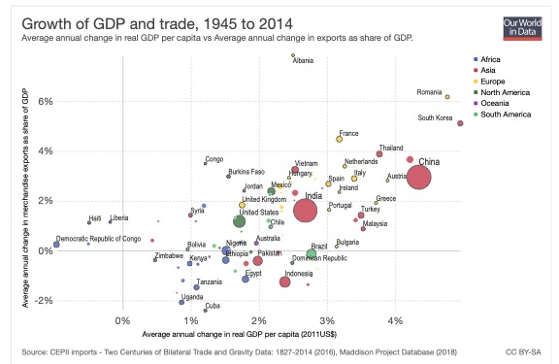

Slide 10
So how could all of this happen under anarchy?

Slide 11
Diplomacy, founded on the Neoliberal theory that IR Realists are wrong

Slide 12
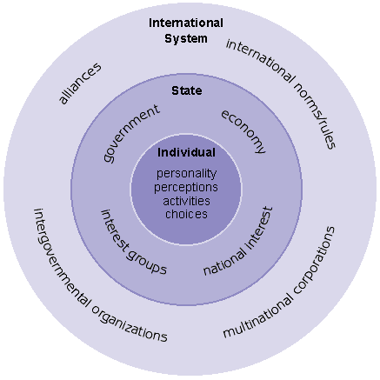
ANARCHY!

Slide 13
Moravcsik’s “Three Hard Core Assumptions” of Liberal IR Theory

Slide 14
Moravcsik’s “Three Hard Core Assumptions” of Liberal IR Theory
1. The fundamental actors in international politics are individuals and groups, not states.

Slide 15
Moravcsik’s “Three Hard Core Assumptions” of Liberal IR Theory
1. The fundamental actors in international politics are individuals and groups, not states.
2. States represent only a subset of domestic society, not a presumed “national interest.”

Slide 16
Moravcsik’s “Three Hard Core Assumptions” of Liberal IR Theory
1. The fundamental actors in international politics are individuals and groups, not states.
2. States represent only a subset of domestic society, not a presumed “national interest.”
3. Combined societal pressures determine “state preferences,” which in turn shape the state’s international behavior.

Slide 17


Keohane and Nye’s “complex (policy) interdependence” finally convinced most Neorealists they had to engage the Neoliberals and show respect
“Complex” or “policy” interdependence refers to the set of costs and benefits created for specific groups in Country B when dominant groups in Country A try to realize their preferences and values in the international realm by influencing their state’s foreign policy. (1977)

Slide 18
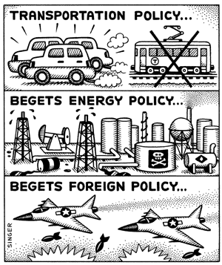

Slide 19

Neorealist Kenneth Waltz doesn’t budge…

Slide 20
But this has to be explained…

Slide 21
…because it’s IMPORTANT

Slide 22


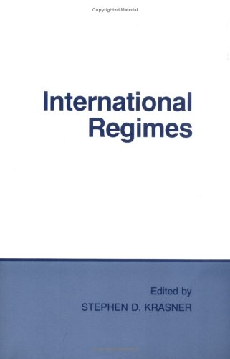

Slide 23
Krasner of Stanford’s
“International Regimes”
International regimes are principles, norms, rules, and decision-making procedures around which state expectations converge in a given issue-area.

Slide 24
Krasner of Stanford’s
“International Regimes”
Regimes are more enduring than mere temporary arrangements that change with every shift in power or interests.

Slide 25
Krasner of Stanford’s
“International Regimes”
Regimes are more enduring than mere temporary arrangements that change with every shift in power or interests. So how does this mark Krasner off as not quite your traditional Realist?

Slide 26
Krasner of Stanford’s
“International Regimes”
Regimes are more enduring than mere temporary arrangements that change with every shift in power or interests. So how does this mark Krasner off as not quite your traditional Realist?
STATES ARE CONSTRAINED. ANARCHY IS LESS!

Slide 27
Influential Regimes of the 21st Century (1 of 2)
World Trade Organization (WTO): The cornerstone regime providing rules and dispute settlement for over 98% of global trade.
Paris Agreement (UNFCCC): The principal global regime to combat climate change by having nations set their own emission reduction targets.
Nuclear Non-Proliferation Treaty (NPT): The critical security regime aimed at preventing the spread of nuclear weapons and promoting disarmament.
International Monetary Fund (IMF): The world's lender of last resort, providing emergency loans and surveillance to ensure global financial stability.
International Criminal Court (ICC): The permanent court that prosecutes individuals for genocide, war crimes, and crimes against humanity.

Slide 28
Influential Regimes of the 21st Century (2 of 2)
The G20 (Group of Twenty): The primary forum for the world's largest economies to coordinate policy on major global economic issues.
The Basel Accords (Basel III): The regime that sets global standards for banking regulation to ensure the stability of the international financial system.
The Kimberley Process (KPCS): A certification scheme designed to stop the trade of "conflict diamonds" used to fund civil wars.
Counter-Terrorism Regime (UNSC 1373): A binding UN Security Council regime requiring all states to take comprehensive measures to combat terrorism.
The Association of Southeast Asian Nations (ASEAN): The key regional organization that serves as the central diplomatic hub for managing security in the Asia-Pacific.

Slide 29
ANARCHY?

Slide 30
Krasner of Stanford’s
“International Regimes”
Regimes are also different from agreements, which are ad hoc, sometimes one-shot arrangements. A key purpose of regimes is to facilitate agreements.

Slide 31
How Regimes Facilitate Agreements

Slide 32
How Regimes Facilitate Agreements
1. Increase Transparency and Provide Information: Regimes create systems for monitoring, reporting, and data sharing. This allows states to observe each other's behavior and intentions more clearly, which reduces the fear, suspicion, and misperception that fuel the security dilemma.

Slide 33
How Regimes Facilitate Agreements
1. Increase Transparency and Provide Information: Regimes create systems for monitoring, reporting, and data sharing. This allows states to observe each other's behavior and intentions more clearly, which reduces the fear, suspicion, and misperception that fuel the security dilemma.
2. Lower the Transaction Costs of Agreement: By providing established forums, legal frameworks, and negotiation procedures (e.g., the WTO), regimes make it significantly easier and cheaper for states to make deals, resolve disputes, and manage complex issues without starting from scratch each time.

Slide 34
How Regimes Facilitate Agreements
1. Increase Transparency and Provide Information: Regimes create systems for monitoring, reporting, and data sharing. This allows states to observe each other's behavior and intentions more clearly, which reduces the fear, suspicion, and misperception that fuel the security dilemma.
2. Lower the Transaction Costs of Agreement: By providing established forums, legal frameworks, and negotiation procedures (e.g., the WTO), regimes make it significantly easier and cheaper for states to make deals, resolve disputes, and manage complex issues without starting from scratch each time.
3. Lengthen the “Shadow of the Future”: Regimes institutionalize interaction, making it clear to states that they will be dealing with each other repeatedly for the long term. This powerful incentive discourages short-term cheating in favor of building a reputation for reliability to secure future cooperation.

Slide 35
How Regimes Facilitate Agreements
1. Increase Transparency and Provide Information: Regimes create systems for monitoring, reporting, and data sharing. This allows states to observe each other's behavior and intentions more clearly, which reduces the fear, suspicion, and misperception that fuel the security dilemma.
2. Lower the Transaction Costs of Agreement: By providing established forums, legal frameworks, and negotiation procedures (e.g., the WTO), regimes make it significantly easier and cheaper for states to make deals, resolve disputes, and manage complex issues without starting from scratch each time.
3. Lengthen the “Shadow of the Future”: Regimes institutionalize interaction, making it clear to states that they will be dealing with each other repeatedly for the long term. This powerful incentive discourages short-term cheating in favor of building a reputation for reliability to secure future cooperation.
4. Define Cheating and Facilitate Reciprocity: Regimes create clear standards of behavior and rules, explicitly defining what constitutes a violation (cheating). This makes it easier to identify non-compliance and allows states to respond with targeted, reciprocal actions (sanctions, etc.) rather than escalating to broader conflict.

Slide 36
Hegemonic Stability Theory

Slide 37
Hegemonic Stability Theory
1. A Hegemon is Necessary for Order: A stable, open, and prosperous international system requires a single dominant state (a “hegemon”) with a preponderance of military and economic power.

Slide 38
Hegemonic Stability Theory
1. A Hegemon is Necessary for Order: A stable, open, and prosperous international system requires a single dominant state (a “hegemon”) with a preponderance of military and economic power.
2. Provision of Public Goods: The hegemon uses its power to provide collective goods that all states benefit from, such as a stable reserve currency (e.g., the British pound in the 19th century, the U.S. dollar post-WWII); military security and enforcement mechanisms (e.g., policing sea lanes to ensure freedom of navigation); a market of last resort to absorb surplus goods during economic downturns; and a source of credit and liquidity in financial crises.

Slide 39
Hegemonic Stability Theory
1. A Hegemon is Necessary for Order: A stable, open, and prosperous international system requires a single dominant state (a “hegemon”) with a preponderance of military and economic power.
2. Provision of Public Goods: The hegemon uses its power to provide collective goods that all states benefit from, such as a stable reserve currency (e.g., the British pound in the 19th century, the U.S. dollar post-WWII); military security and enforcement mechanisms (e.g., policing sea lanes to ensure freedom of navigation); a market of last resort to absorb surplus goods during economic downturns; and a source of credit and liquidity in financial crises.
3. Solving the Free-Rider Problem: Without a hegemon to bear the costs of leadership and enforce the rules, smaller states would enjoy the benefits of an open system without contributing, leading to its eventual collapse.

Slide 40
Hegemonic Stability Theory
1. A Hegemon is Necessary for Order: A stable, open, and prosperous international system requires a single dominant state (a “hegemon”) with a preponderance of military and economic power.
2. Provision of Public Goods: The hegemon uses its power to provide collective goods that all states benefit from, such as a stable reserve currency (e.g., the British pound in the 19th century, the U.S. dollar post-WWII); military security and enforcement mechanisms (e.g., policing sea lanes to ensure freedom of navigation); a market of last resort to absorb surplus goods during economic downturns; and a source of credit and liquidity in financial crises.
3. Solving the Free-Rider Problem: Without a hegemon to bear the costs of leadership and enforce the rules, smaller states would enjoy the benefits of an open system without contributing, leading to its eventual collapse.
4. It's Not a Matter of Altruism: The reason the hegemon is willing to bear the costs of leadership is that it benefits disproportionately from the stable system it maintains. Its dominant economic position on the technological frontier allows it to reap the greatest rewards from an open global system.

Slide 41
Hegemonic Stability Theory
1. A Hegemon is Necessary for Order: A stable, open, and prosperous international system requires a single dominant state (a “hegemon”) with a preponderance of military and economic power.
2. Provision of Public Goods: The hegemon uses its power to provide collective goods that all states benefit from, such as a stable reserve currency (e.g., the British pound in the 19th century, the U.S. dollar post-WWII); military security and enforcement mechanisms (e.g., policing sea lanes to ensure freedom of navigation); a market of last resort to absorb surplus goods during economic downturns; and a source of credit and liquidity in financial crises.
3. Solving the Free-Rider Problem: Without a hegemon to bear the costs of leadership and enforce the rules, smaller states would enjoy the benefits of an open system without contributing, leading to its eventual collapse.
4. It's Not a Matter of Altruism: The reason the hegemon is willing to bear the costs of leadership is that it benefits disproportionately from the stable system it maintains. Its dominant economic position on the technological frontier allows it to reap the greatest rewards from an open global system.
5. Hegemonic Decline Leads to Instability: When the hegemon's power declines, or it loses the will to lead, the international system is prone to becoming chaotic, protectionist, and conflict-ridden.

Slide 42
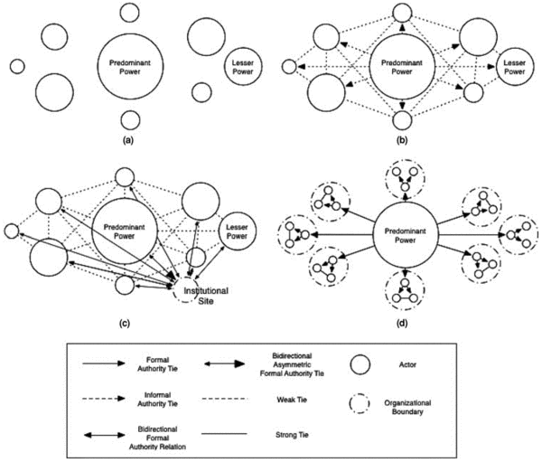
Hegemonic Stability Theory

Slide 43
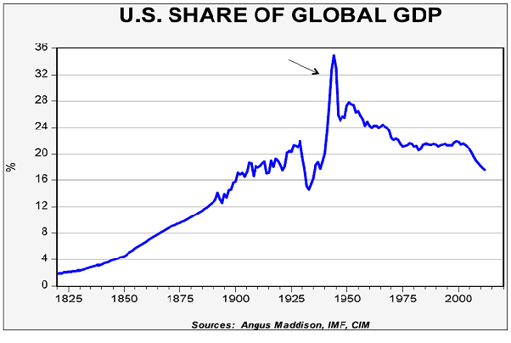

Slide 44
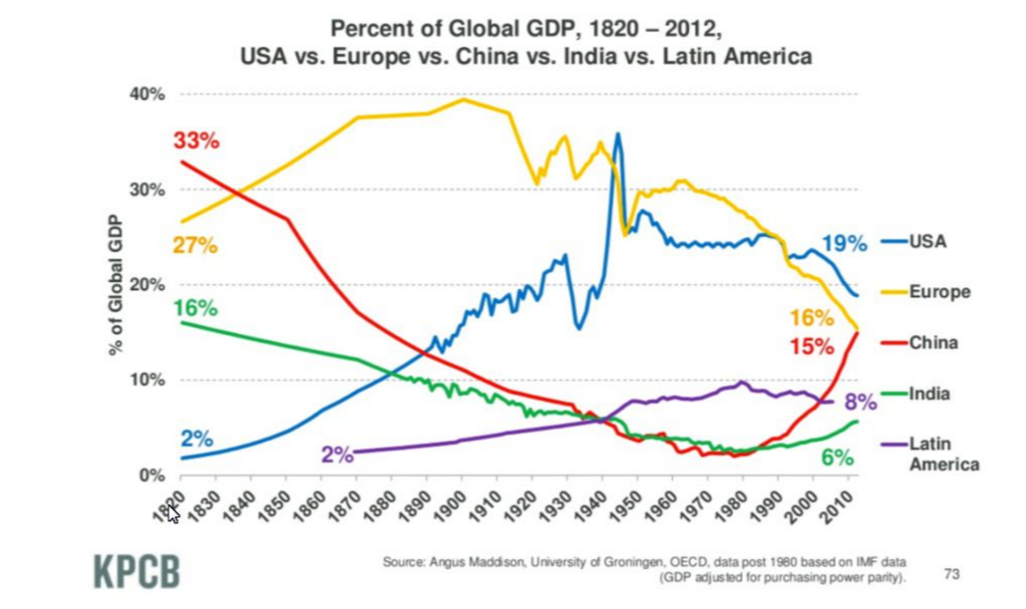

Slide 45
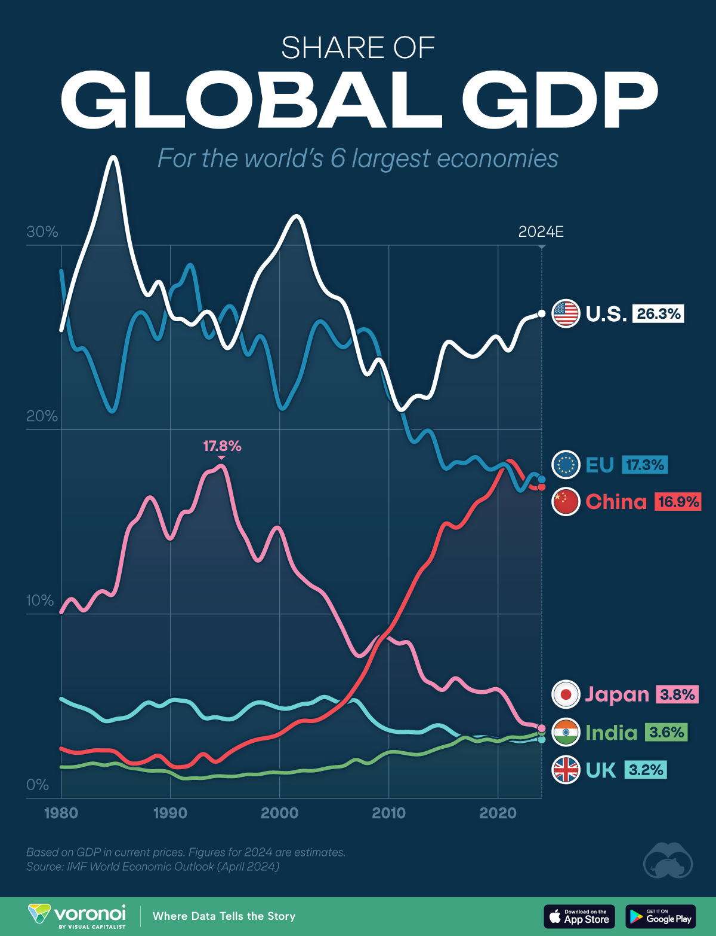

Slide 46
Even when U.S. hegemony fades (Japanese and West German power surge),
the world trade regime continued to function and even to advance until recently.
SO WHAT EXPLAINS THIS HIGH DEGREE OF STATE COOPERATION UNDER ANARCHY?

Slide 47
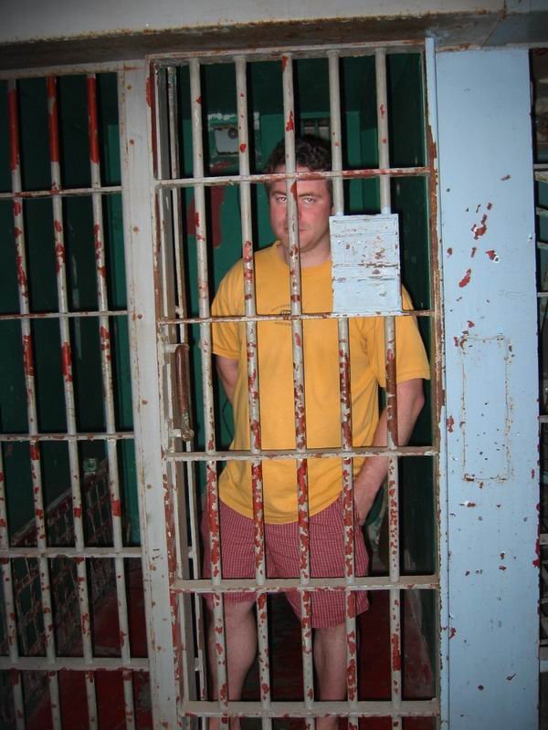
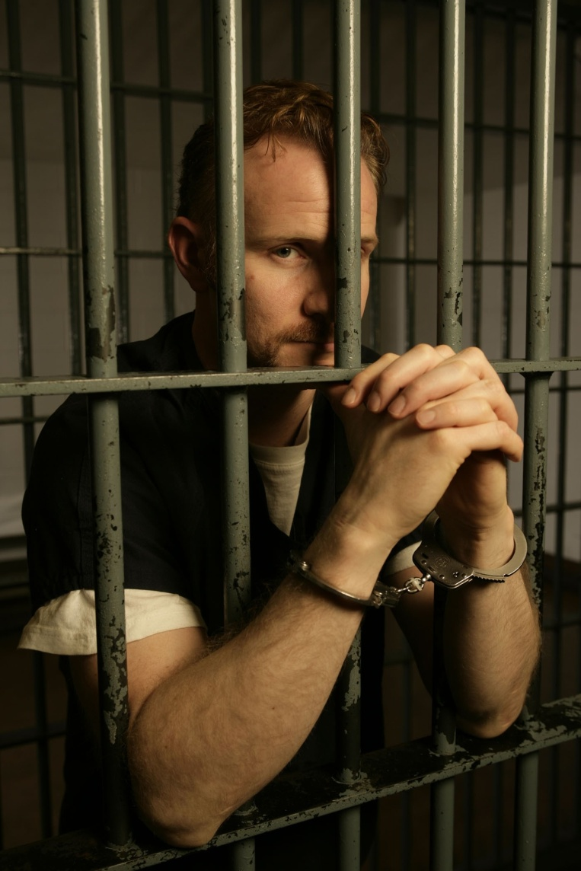
The Prisoners’ Dilemma

Slide 48
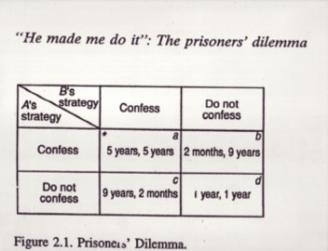
The Prisoners’ Dilemma

Slide 49
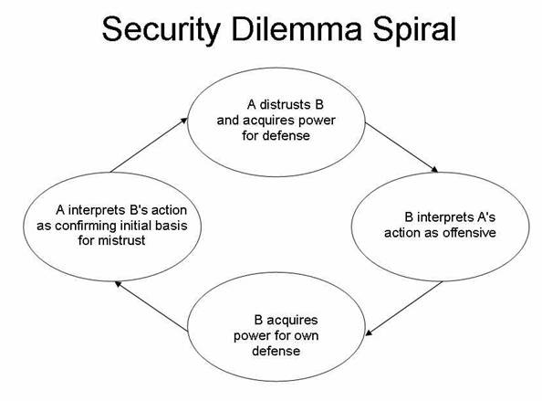
Can the security dilemma be modeled as a PD?

Slide 50
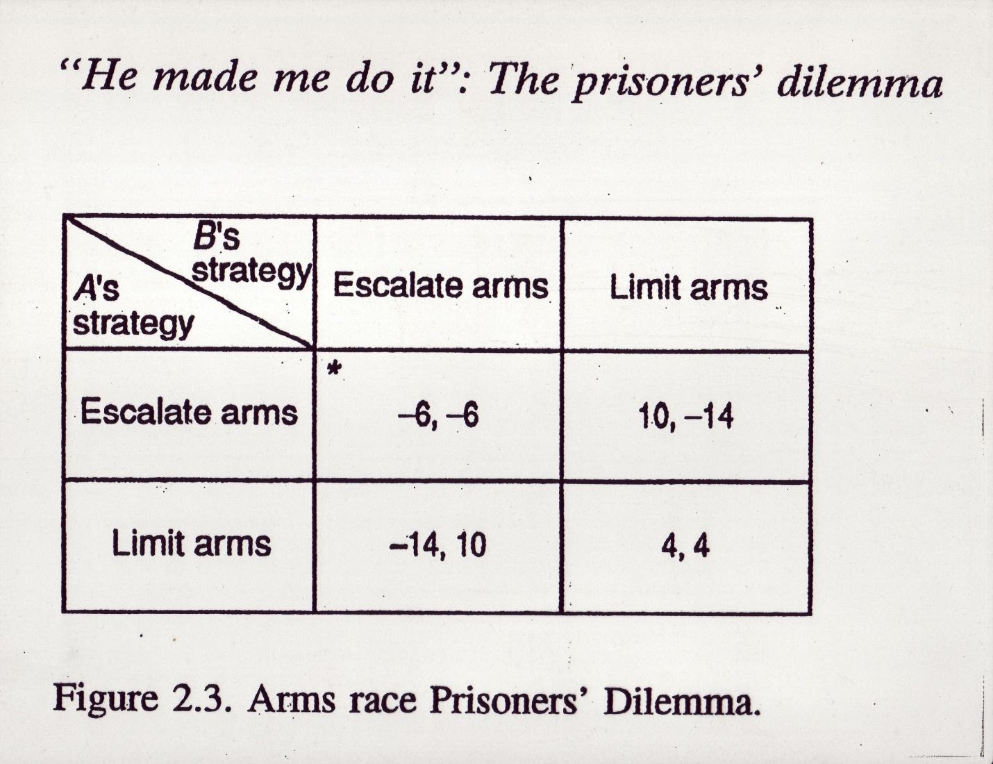

Slide 51
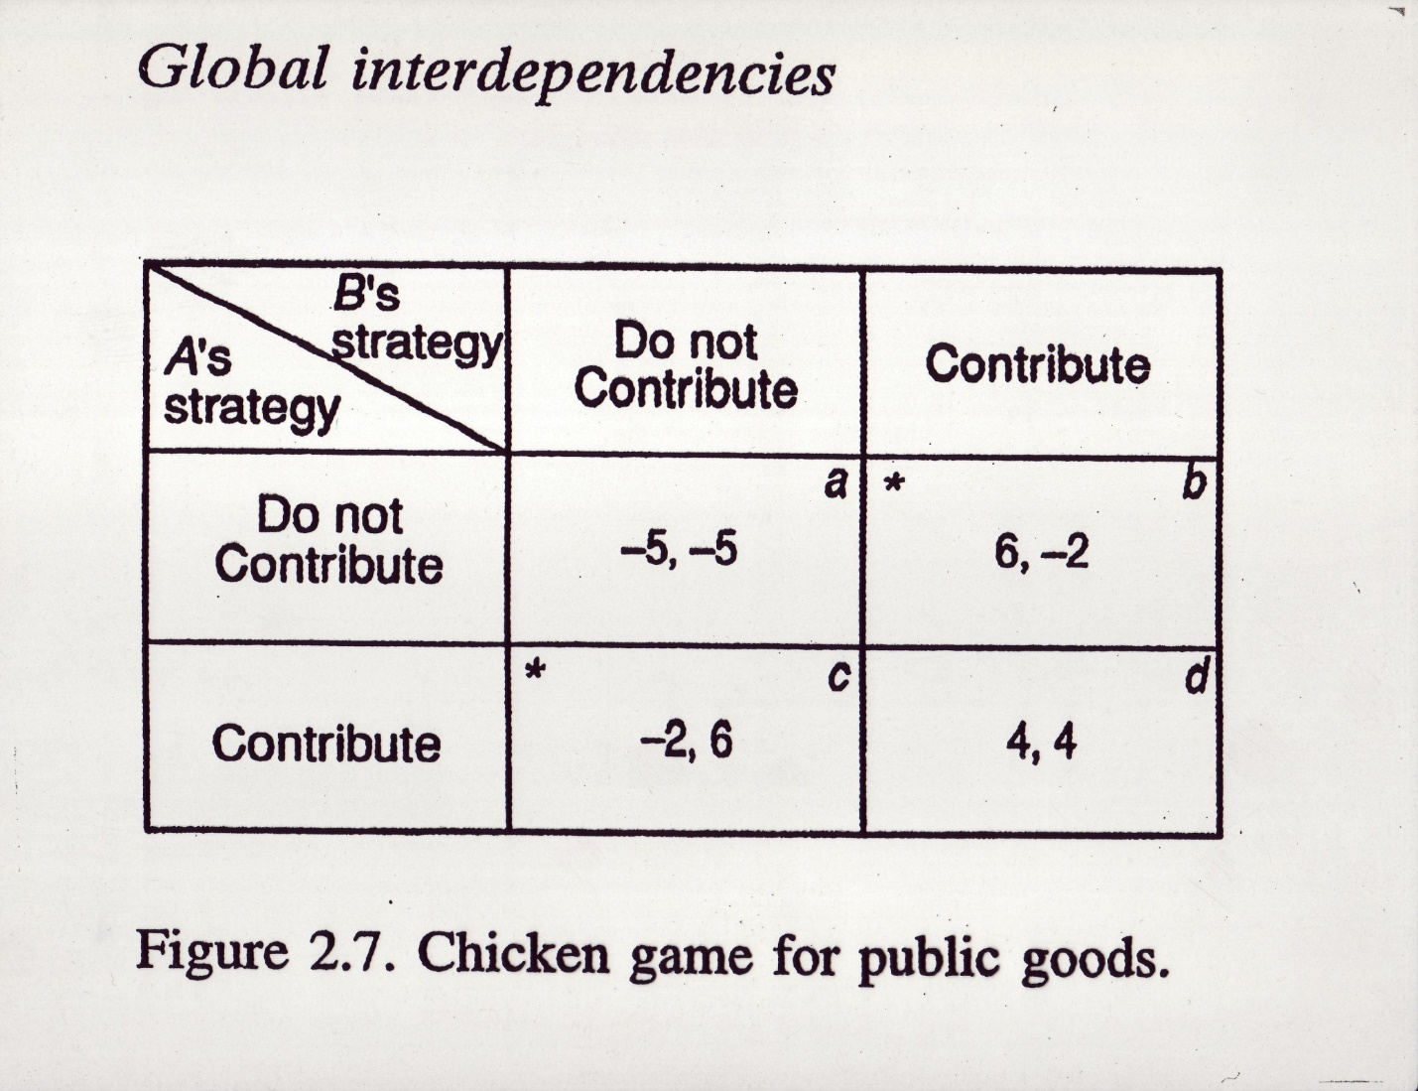
!!~~> C H I C K E N <~~!!
Imagine the U.S. as A and China as B

Slide 52
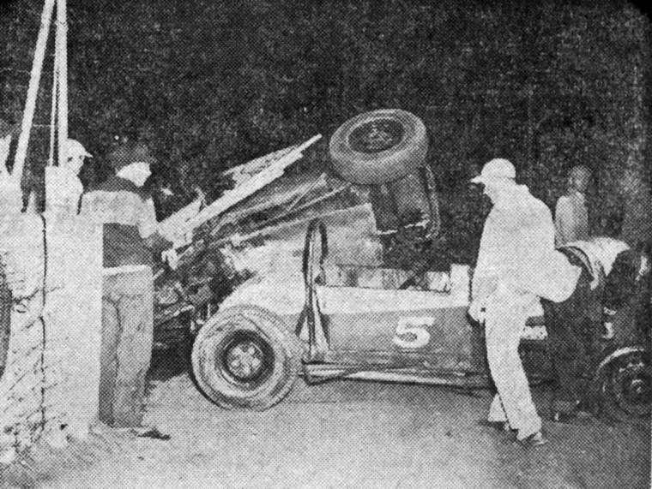
But someone didn’t behave rationally the night of
July 13th,1950 in Wichita, Kansas

Slide 53
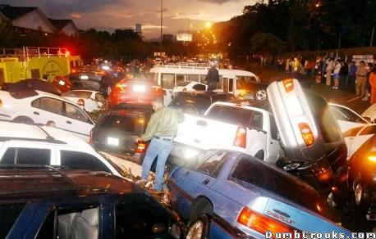
How to prevent the car crashes of international relations?

Slide 54
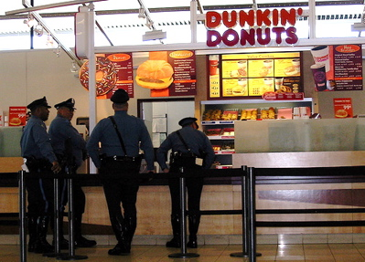


Slide 55

Iterated (multiple-round) Prisoners Dilemma:
Suddenly the shadow of the future looms

Slide 56
EVEN IN A HOBBESIAN WORLD, looking like a PD, the best long-term strategy is: tit for tat

Slide 57
EVEN IN A HOBBESIAN WORLD, looking like a PD, the best long-term strategy is: tit for tat
1. Always cooperate with the other player at first; that is, don’t be the first one to defect.

Slide 58
EVEN IN A HOBBESIAN WORLD, looking like a PD, the best long-term strategy is: tit for tat
1. Always cooperate with the other player at first; that is, don’t be the first one to defect.
2. If the other player defects, retaliate immediately—but only once. Don’t be vengeful.

Slide 59
EVEN IN A HOBBESIAN WORLD, looking like a PD, the best long-term strategy is: tit for tat
1. Always cooperate with the other player at first; that is, don’t be the first one to defect.
2. If the other player defects, retaliate immediately—but only once. Don’t be vengeful.
3. If the other player resumes cooperating, then resume cooperating. But if s/he keeps defecting, then keep defecting.

Slide 60
The 2nd to WORST strategy is:
The Sociopathic Strategy
(always defect)

Slide 61
The WORST strategy is:
The Jesus Strategy
(always cooperate)

Slide 62


Slide 63
Possibly Realists are right that states were born as war-fighting machines and still tend toward suspicion of each other because of the security dilemma.

Slide 64
Possibly Realists are right that states were born as war-fighting machines and still tend toward suspicion of each other because of the security dilemma.
But over the ages, states that fail to cooperate will gradually be eliminated from the world scene. Completely naïve states will also be eliminated.

Slide 65
Possibly Realists are right that states were born as war-fighting machines and still tend toward suspicion of each other because of the security dilemma.
But over the ages, states that fail to cooperate will gradually be eliminated from the world scene. Completely naïve states will also be eliminated.
The surviving states will be those that prosper through the benefits cooperation confers when balanced by a vigorous—yet reasonable—defense of state interests.

Slide 66
Possibly Realists are right that states were born as war-fighting machines and still tend toward suspicion of each other because of the security dilemma.
But over the ages, states that fail to cooperate will gradually be eliminated from the world scene. Completely naïve states will also be eliminated.
The surviving states will be those that prosper through the benefits cooperation confers when balanced by a vigorous—yet reasonable—defense of state interests.
SO REALISTS MUST RECONSIDER SEVERAL ISSUES: the world as anarchic today, the impossibility of progress, etc.

Slide 67
The Neo-Neo Debate
Neorealists responded to the Neoliberals’ core contribution by contending that its presuppositions are flawed:

Slide 68
The Neo-Neo Debate
Neorealists responded to the Neoliberals’ core contribution by contending that its presuppositions are flawed:
Neoliberals can only use “evolution of cooperation” models by assuming states primarily seek absolute gains in their interactions each other; that is, gains compared to the past or what would have been possible from alternative courses of action.

Slide 69
The Neo-Neo Debate
Neorealists responded to the Neoliberals’ core contribution by contending that its presuppositions are flawed:
Neoliberals can only use “evolution of cooperation” models by assuming states primarily seek absolute gains in their interactions each other; that is, gains compared to the past or what would have been possible from alternative courses of action.
But Neorealists assert that, owing to the security dilemma, states primarily seek relative gains in their interactions with each other. Peace may be passing!

Slide 70
The Neo-Neo Debate

Slide 71
The Neo-Neo Debate
1. Both sides agree that regimes exist and are important.

Slide 72
The Neo-Neo Debate
1. Both sides agree that regimes exist and are important.
2. Neorealists think powerful states are relatively less constrained by regime norms and rules.

Slide 73
The Neo-Neo Debate
1. Both sides agree that regimes exist and are important.
2. Neorealists think powerful states are relatively less constrained by regime norms and rules.
3. But Neoliberals insist that once regimes are created, they ensnare all states in webs of governance that profoundly undermine anarchy.

